Slide 1


Denis Levert
October 11, 2021

Slide 2

Outline
Executive Summary
Introduction
Methodology
Results
Conclusion
Appendix

Slide 3
Executive Summary
The methodology used in this report follows the CRISP-DM methodology from John Rollins. In summary, it consists of the following main phases:
From problem to approach.
Working with data.
Deriving the answer.
Summary of all results
Launch outcomes are becoming more successful and payloads can be matched for even higher success rates.
The Orbits can affect the landing predictability and several have 100% success rate.
The launch site can be selected for the highest success rate.
The booster can be selected along with the payload range for the best chance of a successful landing. The most successful booster can be chosen based on payload required to be launched.
Prediction can be made with an 89% accuracy.

Slide 4
Introduction
Project background and context
SpaceY funded by Allon Mask is looking to determine the price of each launch for their new space program.
SpaceX has the best data and success rate. Their data is available to analyze.
Problems you want to find answers
What does SpaceX data tell us about the landing predictability of the Falcon 9 booster?
Can the probability of a first stage landing be predicted?
Can this data be used to predict the cost of a launch for SpaceY?

Slide 5


Slide 6
Methodology
Executive Summary
Data collection methodology:
Data was collected using API calls to https://api.spacexdata.com/v4. Then the data was filtered for Falcon 9.
Perform data wrangling
Payload nulls were replaced with the median. Data was explored to understand it, and then a column created to Classify the landings as a success or failure.
Perform exploratory data analysis (EDA) using visualization and SQL
Perform interactive visual analytics using Folium and Plotly Dash
Perform predictive analysis using classification models
How to build, tune, evaluate classification models

Slide 7
Data Collection
The datasets were collected using REST API’s from the Space X site https://api.spacexdata.com/v4.
The intent is to collect enough data to determine if the first phase be reused to determine the cost of a launch and if a company can competitively bid against Space X.
Space X data will be collected, cleaned, analyzed, and then explored further.
Business Understanding
Analytic Approach
Data Collection
Data Requirements
Data Understanding
Data Preparation
Modelling
Evaluation
Deployment
Feedback

Slide 8
Data Collection – SpaceX API
a
https://api.spacexdata.com/v4
The data was collected from https://api.spacexdata.com/v4. 5 separate REST API’s were called to collect the Rocket, Launchpad, Payloads, Cores, and Launches data.
The data was then parsed, stored in lists, converted to dictionaries, using the ID columns converted to a data frame.
The dataset was filtered to Falcon 9 launches only.
The Jupyter notebook can be found at: https://github.com/dlevert/DSProject/blob/1058d4efddc46242e8fa28e001fc2cc99c776617/Lab%201%20Collecting%20the%20data.ipynb
Rocket Data
Payloads Data
Core Data
Launchpad Data
Past Launches
Web Scraping
Normalize Data
Convert to data frame
Filter for Falcon 9 launches
Insert median for missing values of Payload Mass
Complete Dataset

Slide 9
Data Collection - Scraping
The launch API returned a lot of data. The data was parsed into a data frame (data) using a JSON normalize function, then relevant columns extracted.
From here the relevant columns from the rest of the data was extracted into a dictionary.
The dictionary was converted to a data frame
The Jupyter notebook can be found at: https://github.com/dlevert/DSProject/blob/1058d4efddc46242e8fa28e001fc2cc99c776617/Lab%201%20Collecting%20the%20data.ipynb
a
Launch Data
JSON Normalize
Column Extraction
Remaining Data
Dictionary
Data Frame

Slide 10
Data Wrangling
The data was checked for null values. The columns data types were checked. Launches evaluated by site. Orbits evaluated by type and then checked against a positive outcome. A landing outcome was determined and loaded into the ‘Class’ column. An overall success rate of 66.7% was observed in the data.
The Jupyter notebook can be found here: https://github.com/dlevert/DSProject/blob/1058d4efddc46242e8fa28e001fc2cc99c776617/Lab%202%20Data%20wrangling.ipynb
Check for Null Values
Check Data Types
Evaluate Launches by Site
Evaluate Orbits by type
Analyze Orbit type to Outcome
Establish variable for positive outcomes (Class)

Slide 11
EDA with Data Visualization
Several charts were explored to look for relationship’s in the success of a first stage landing.
Payload mass vs. flight number shows that generally mass went up over time as well as success rate.
Launch site vs. flight number indicates that there are more successful landings with more flights. Landing site 4E has a high success rate.
Payload vs. launch site indicates heavier loads have a high success rate.
Success rate by orbit type indicates ES-L1, GEO, HEO, and SSO have the highest success rate, while SO has the worst success rate.
Orbit vs. flight number does not seem to have an impact.
Orbit type vs. payload doesn’t seem to make a difference except for GTO orbit it has a negative impact.
Success rate over year has a positive impact on success rate, indicating an improvement over time.
The Jupyter notebook can be found here: https://github.com/dlevert/DSProject/blob/1058d4efddc46242e8fa28e001fc2cc99c776617/Lab%204%20Exploring%20and%20Preparing%20Data.ipynb

Slide 12
EDA with SQL
The following SQL analysis was performed:
Summarized the launch sites.
Displayed 5 records starting with ‘CCA’.
Totaled the payload mass launched by NASA (CRS).
Averaged the payload mass carried by booster version F9 v1.1.
Queried the first successful ground pad landing.
Queried the boosters that had successful drone ship landings carrying a payload mass between 4,000 and 6,000 kg.
Summarized the total success and failure mission outcomes.
Queried the booster versions that carried the maximum payload mass.
Queried the booster version and the launch site that failed a drone ship landing in the year 2015.
Ranked the landing outcomes in descending order between the dates 2010-06-04 and 2017-03-20.
The Jupyter notebook can be found here: https://github.com/dlevert/DSProject/blob/1058d4efddc46242e8fa28e001fc2cc99c776617/Lab%203%20SQL%20Notebook.ipynb

Slide 13
Build an Interactive Map with Folium
The Folium map was plotted and the following objects created:
Circles: Used to identify geographical locations of sites to clearly show where the launches took place.
Markers: used to pinpoint locations.
Marker Clusters: used to group the markers and visualize quantity, allowing to zoom into the points to represent quantity and visually display success rates..
Text marker: Used to display information (Distance in this example).
Lines: Used to reference between two points. The launch site and the nearest points of interest.
The Jupyter notebook can be found here: https://github.com/dlevert/DSProject/blob/1058d4efddc46242e8fa28e001fc2cc99c776617/Lab%205%20Analysis%20with%20Folium.ipynb
Afor readability, I have included an NB Viewer link that displays the interactive maps: https://nbviewer.org/github/dlevert/DSProject/blob/1058d4efddc46242e8fa28e001fc2cc99c776617/Lab%205%20Analysis%20with%20Folium.ipynb

Slide 14
Build a Dashboard with Plotly Dash
A dashboard is built to allow user interface with the data and allow the ability to drilldown into it. The following graphs and interactions where built:
A dropdown was created to select one or all launch sites. The dropdown filters the entire dashboard to focus on location.
A pie chart was added; When ‘All Sites’ is selected it displays the percent of successful outcome by site. When a specific launch site is selected, it displays the ratio between successful and unsuccessful outcome.
A scatter chart was added to display payload vs. launch outcome. The color is set to the booster version. This graph filters with the launch site dropdown.
A slider was built to range the payload mass in the scatter chart. This allow interactivity and exploring the best combination of payload mass, launch site and booster version.
The Jupyter notebook can be found here: https://github.com/dlevert/DSProject/blob/1058d4efddc46242e8fa28e001fc2cc99c776617/Lab%206%20Pandas%20Dash.ipynb

Slide 15
Predictive Analysis (Classification)
The dataset was loaded then:
The Class column was assigned to the ‘Y’ variable.
The remaining variables where preprocessed and fit to a standard scaler transformation, then set to the ‘X’ variable.
The data was split into train(80%) and test(20%) sets.
The GridSearchCV method was used to ‘fit’ and ‘score’. The ‘best parameters’ and ‘best score’ was evaluated for the following methods:
Logistic Regression
Support Vector Machine
Decision Tree
K Nearest Neighbor
A confusion matrix was built for each method.
I final matrix to display the comparison of the models.
The Jupyter notebook can be found here: https://github.com/dlevert/DSProject/blob/1058d4efddc46242e8fa28e001fc2cc99c776617/Lab%207%20Landing%20Prediction.ipynb
Load Data
Assign class variable to Y
Use GridSearchCV to test different models
Preprocess data using standard scaler transformation
Split data into training and testing sets
Generate confusion matrixes
compare model results

Slide 16
Results
Exploratory data analysis results
Interactive analytics demo in screenshots
Predictive analysis results

Slide 17


Slide 18
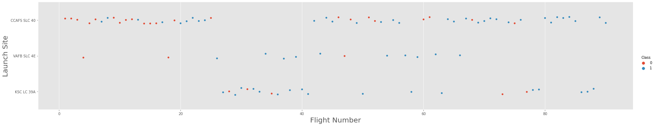
Flight Number vs. Launch Site
This plot shows the flight numbers and which launch site it was from with the color showing the outcome 0 for negative and 1 for successful.
It does indicate many negative outcomes early and more successful outcomes later.
CCAFS SLC 40 is the most used launch site, VAFB SLC 4E the least used.

Slide 19
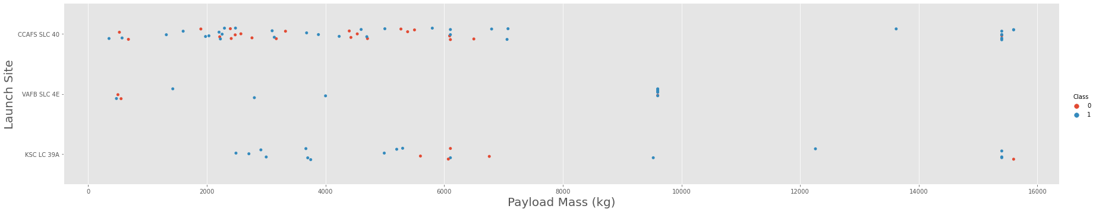
Payload vs. Launch Site
This plot shows the payload mass and which launch site it was from with the color showing the outcome 0 for negative and 1 for successful.
The data indicates that as the payload mass increases, so does the probability of a successful outcome.
There are a lot of negative outcomes with lower payload masses.

Slide 20
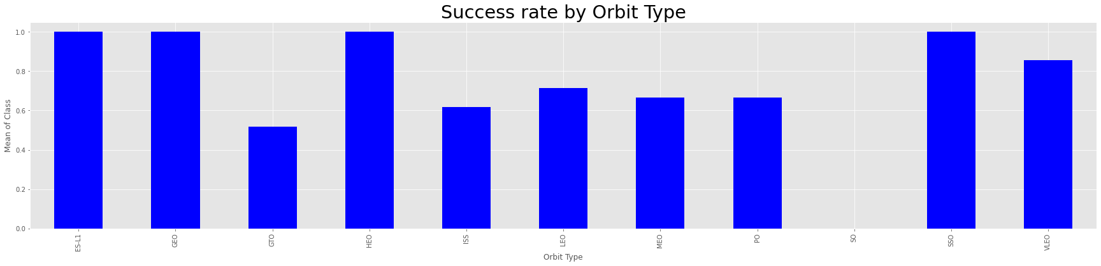
Success Rate vs. Orbit Type
This plot shows the orbit type and which the mean of the outcome (Success rate).
Orbits ES-L1, GEO, HEO, and SSO have a 100% success Rate.
SO has the lowest success rate.

Slide 21
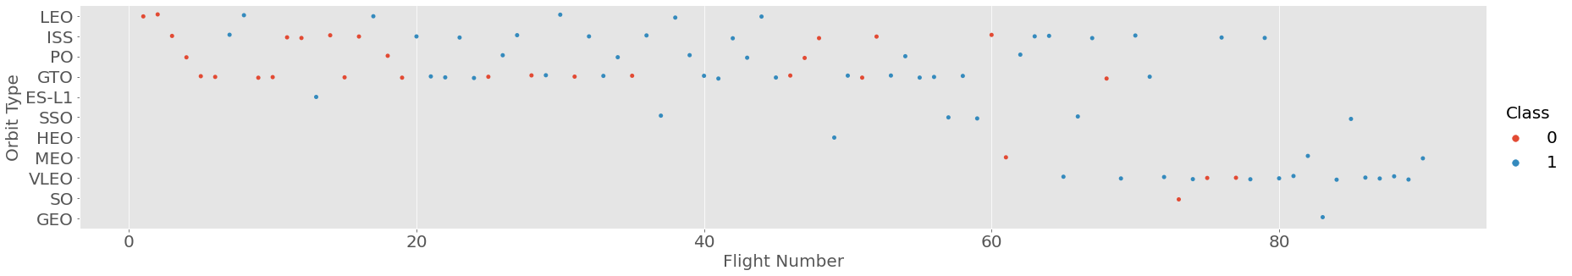
Flight Number vs. Orbit Type
This plot shows the flight number and which orbit type with the color showing the outcome 0 for negative and 1 for successful.
The data suggests LEO orbits got better over the number of attempts.
GTO orbits are spurratic and not getting better over the number of attempts.

Slide 22
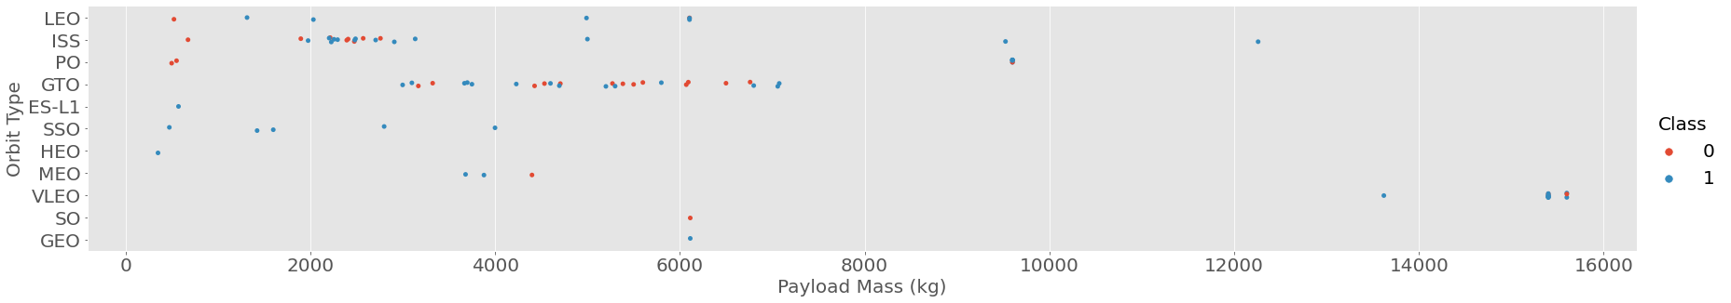
Payload vs. Orbit Type
This plot shows the payload mass and which orbit type with the color showing the outcome 0 for negative and 1 for successful.
Orbits LEO and ISS seem to have more successful outcomes with heavier payload mass.
The GTO orbit seems to have more negative outcomes as the payload mass increases.

Slide 23
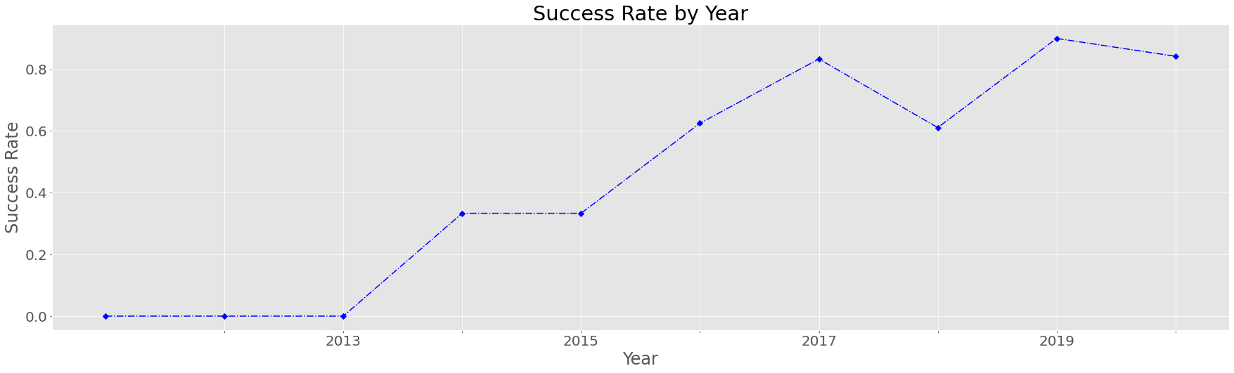
Launch Success Yearly Trend
This plot shows the success rate by year.
The trend shows that the success rate improving over time.
The only anomaly is 2018 where there was a dip in success rate.

Slide 24
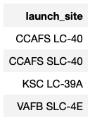
All Launch Site Names
SQL Statement
%sql\
select launch_site\
from SPACEXTBL\
group by launch_site
The above statement groups the data to produce the summary table of launch sites in the dataset.

Slide 25
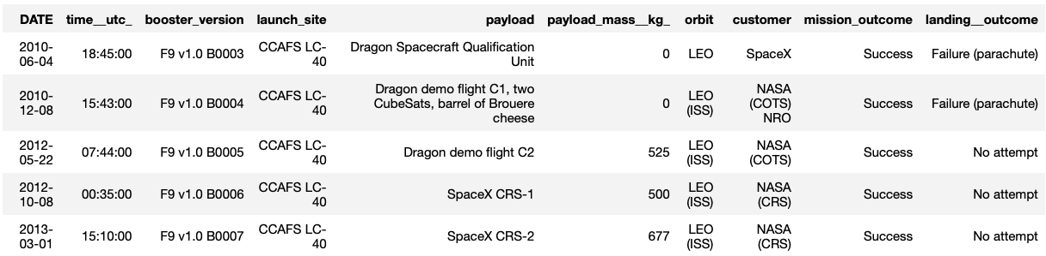
Launch Site Names Begin with 'CCA'
SQL statement:
%sql\
select *\
from SPACEXTBL\
where launch_site like 'CCA%'\
limit(5)
The above statement selects the data where the launch sites start with CCA.

Slide 26
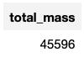
Total Payload Mass
SQL statement:
%sql\
select sum(payload_mass__kg_) as Total_Mass\
from SPACEXTBL\
where customer = 'NASA (CRS)’
The above statement filters the data for boosters carried by NASA and sums the total mass.

Slide 27
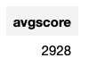
Average Payload Mass by F9 v1.1
SQL statement:
%sql\
select avg(payload_mass__kg_) as avgscore\
from SPACEXTBL\
where booster_version = 'F9 v1.1’
The above statement filters the data for booster version ‘F9 v1.1’ and then averages the payload mass.

Slide 28
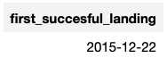
First Successful Ground Landing Date
SQL Statement:
%sql\
select min(DATE) as First_Succesful_Landing\
from SPACEXTBL\
where landing__outcome like '%ground pad%’
The above statement creates a subquery to filter the data for a ground pad landing and then filters the date column for it’s minimum data to return the first successful ground landing date.

Slide 29
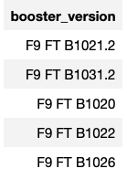
Successful Drone Ship Landing with Payload between 4000 and 6000
SQL Statement:
%sql\
select booster_version\
from SPACEXTBL\
where payload_mass__kg_ >4000 and
payload_mass__kg_ <6000 and
landing__outcome like '%drone%'\
group by booster_version
The above statement filters the data first for payload mass over 4,000 kg, then filters for payload mass under 6,00 kg, and finally for a drone landing outcome. It then returns the booster version.

Slide 30
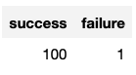
Total Number of Successful and Failure Mission Outcomes
SQL Statement:
%sql\
select sum(mission_outcome like '%Success%') as Success,
sum(mission_outcome like '%Fail%') as Failure\
from SPACEXTBL
The above statement creates two variables, one for outcomes that contain success and one for outcomes that contain failure and then retuirns the sum of these outcomes.

Slide 31
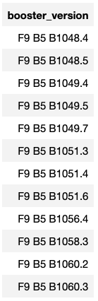
Boosters Carried Maximum Payload
SQL Statement:
%sql\
select unique(booster_version)\
from SPACEXTBL\
where payload_mass__kg_ = (select max(payload_mass__kg_) from SPACEXTBL)
The above statement subqueries the data for the boosters carrying the maximum payload, then selects the unique booster versions.

Slide 32
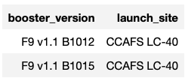
2015 Launch Records
SQL Statement:
%sql\
select booster_version, launch_site\
from SPACEXTBL\
where landing__outcome =\
'Failure (drone ship)' and date like('%2015%’)
The above statement filters the booster version and launch site from the data where the outcome was a failed drone ship landing in the year 2015.

Slide 33
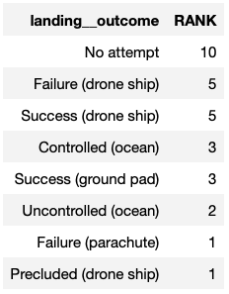
Rank Landing Outcomes Between 2010-06-04 and 2017-03-20
SQL Statement:
%sql\
select landing__outcome, count(landing__outcome)as rank\
from SPACEXTBL\
where DATE > '2010-06-04' and DATE < '2017-03-20'\
group by landing__outcome\
order by rank DESC
The above statement groups the landing outcomes and filters the dataset between 2010-06-04 and 2017-03-20 and then orders by the landing outcome rank.

Slide 34


Slide 35
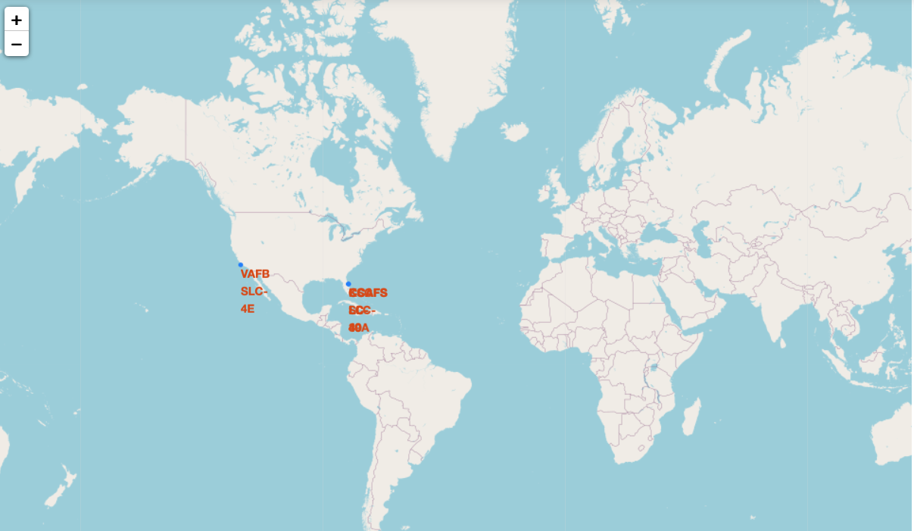
Launch Site Locations
One launch site is located on the west coast of the United States.
3 launch location are located on the east coast of the United States.

Slide 36
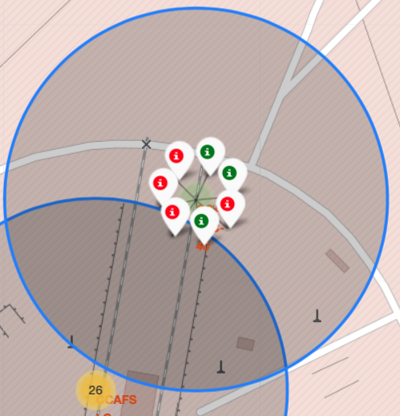
Launch site Outcomes for CCAFS SLC-40
The map shows the launch location CCAFS SLC-40, located right next to CCAFS LC-40.
The map shows a total of 7 launches from this site.
There were 4 unsuccessful landings from this site (indicated in red).
There were 3 successful launches from this site (indicated in green).

Slide 37
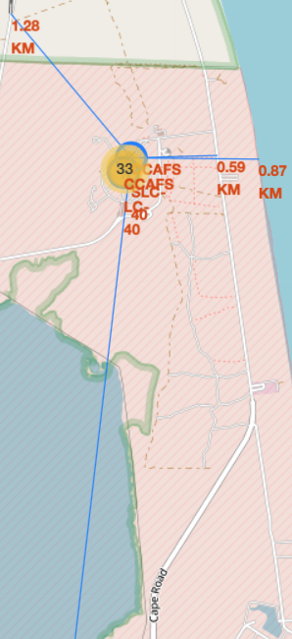
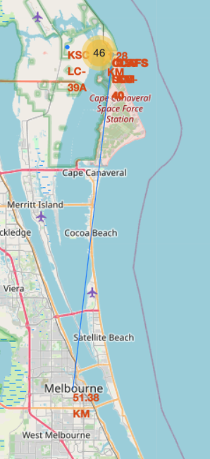
CCAFS SLC-40 Proximity to Landmarks
CCAFS SLC-40 launch site proximity to landmarks as follows:
1.28 km from a railroad.
0.59 km from a major road.
0.87 km from the ocean.
51.38 km from the nearest city (Melbourne)

Slide 38


Slide 39
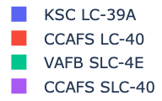
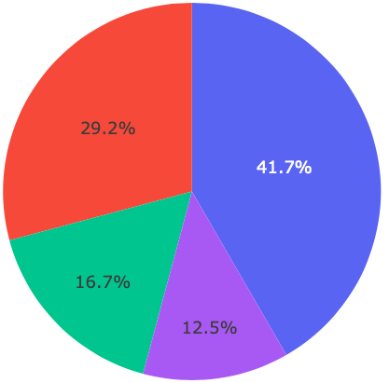
Launch Outcomes Across All Sites
The pie chart shows that 41.7% of the successful mission outcomes come from KSC LC-391 Site.
The second most successful mission outcomes are from CCAFS LC-40.
CCAFS SLC-40 had the least amount of successful mission outcomes.

Slide 40
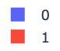
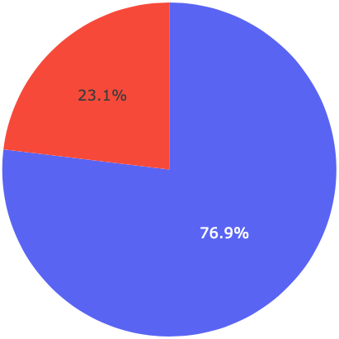
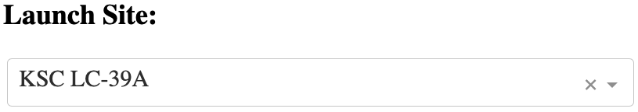
Launch Site KSC LC-39A Success Rate
The launch site KSC LC-391 has the highest success rate amongst all the sites.
23.1% failure rate in this site.
76.9% success rate.

Slide 41
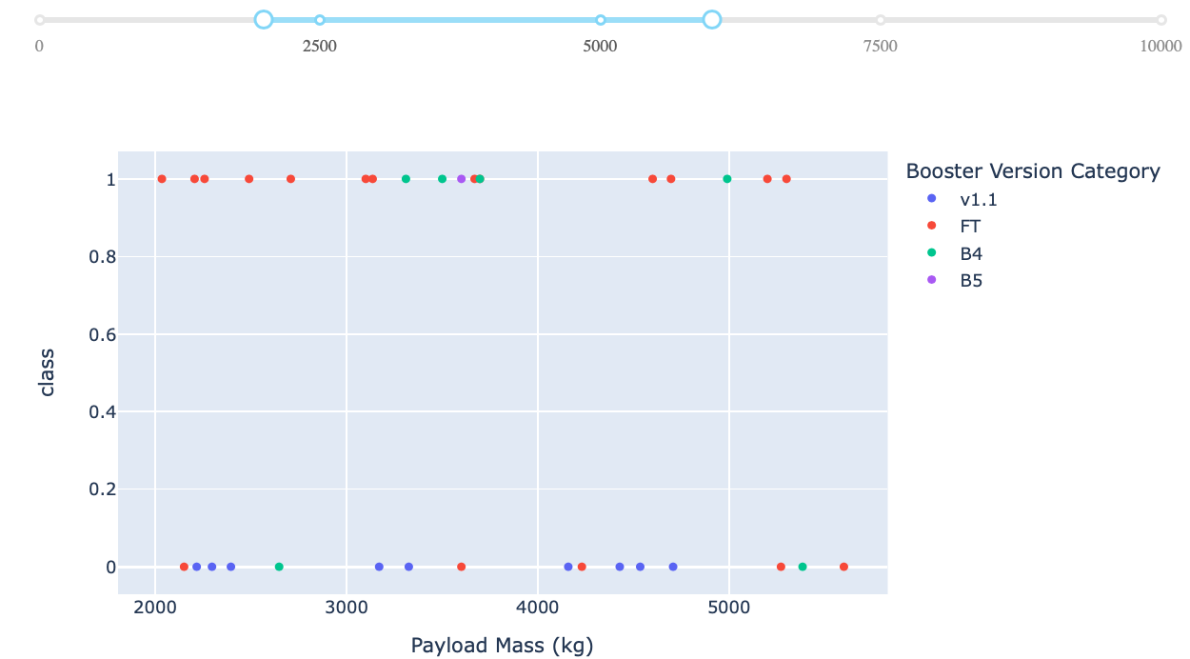
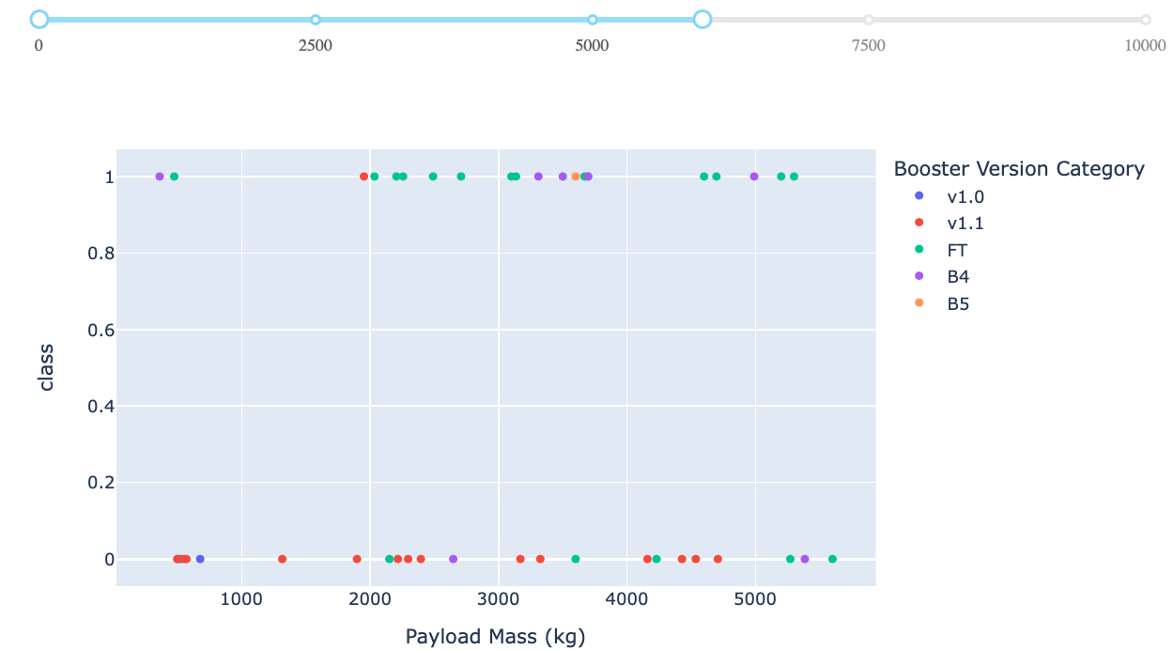
<Dashboard Screenshot 3>
The FT booster operated very well in the 2,000 to 6,000 kg payload range.
The B4 booster does not seem to get constant outcomes regardless of payload.

Slide 42


Slide 43
Classification Accuracy
The decision tree algorithm provides the most accurate results.

Slide 44
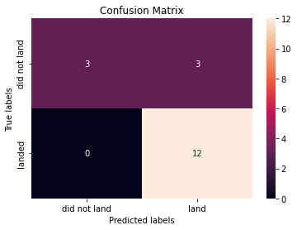
Confusion Matrix
The decision tree confusion matrix is shown here.
It predicts the true landed variable accurately.
It does not accurately predict when the outcome is “did not land’

Slide 45
Conclusions
Launch outcomes have become more positive over time.
Launch outcomes become more positive with higher payloads.
Orbits ES-L1, GEO, HEO, and SSO have a 100% success Rate.
The launch site KSC LC-391 has the highest success rate at 76.9%.
The FT booster has the highest success rate and works best in a payload range of 2,000 to 6,000 kg range.
The most successful booster can be chosen based on payload required to be launched.
Prediction can be made with an 89% accuracy.

Slide 46
Appendix
Relevant Datasets
Dataset 1 - https://github.com/dlevert/DSProject/blob/1058d4efddc46242e8fa28e001fc2cc99c776617/dataset_part_1.csv
Dataset 2 - https://github.com/dlevert/DSProject/blob/1058d4efddc46242e8fa28e001fc2cc99c776617/dataset_part_2.csv
Dataset 3 - https://github.com/dlevert/DSProject/blob/1058d4efddc46242e8fa28e001fc2cc99c776617/dataset_part_3.csv
Dash dataset - https://github.com/dlevert/DSProject/blob/1058d4efddc46242e8fa28e001fc2cc99c776617/spacex_launch_dash.csv
Geo Data - https://github.com/dlevert/DSProject/blob/1058d4efddc46242e8fa28e001fc2cc99c776617/spacex_launch_geo.csv
Python Notebooks
Collecting Data - https://github.com/dlevert/DSProject/blob/1058d4efddc46242e8fa28e001fc2cc99c776617/Lab%201%20Collecting%20the%20data.ipynb
Data Wrangling - https://github.com/dlevert/DSProject/blob/1058d4efddc46242e8fa28e001fc2cc99c776617/Lab%202%20Data%20wrangling.ipynb
SQL - https://github.com/dlevert/DSProject/blob/1058d4efddc46242e8fa28e001fc2cc99c776617/Lab%203%20SQL%20Notebook.ipynb
Exploring & Preparing Data - https://github.com/dlevert/DSProject/blob/1058d4efddc46242e8fa28e001fc2cc99c776617/Lab%204%20Exploring%20and%20Preparing%20Data.ipynb
Location Analysis - https://github.com/dlevert/DSProject/blob/1058d4efddc46242e8fa28e001fc2cc99c776617/Lab%205%20Analysis%20with%20Folium.ipynb
Dash Dashboard - https://github.com/dlevert/DSProject/blob/1058d4efddc46242e8fa28e001fc2cc99c776617/Lab%206%20Pandas%20Dash.ipynb
Landing Prediction - https://github.com/dlevert/DSProject/blob/1058d4efddc46242e8fa28e001fc2cc99c776617/Lab%207%20Landing%20Prediction.ipynb
Github Repository - https://github.com/dlevert/DSProject.git

Slide 47
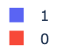
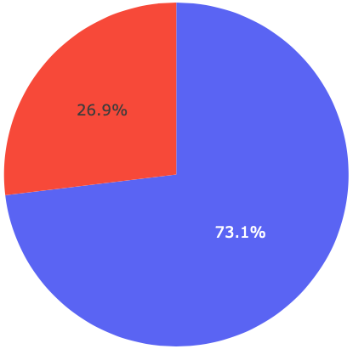
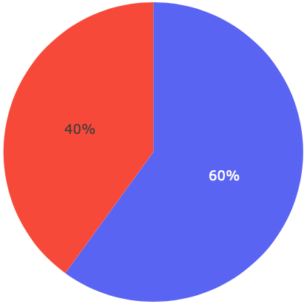
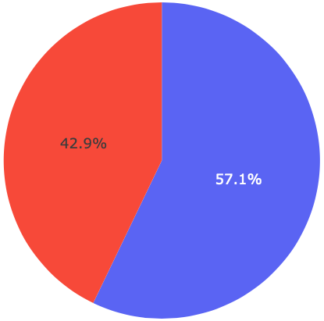
Appendix
Other Dashboard Pie Charts

Slide 48
Method | Score | Best Score
Linear Regression | 0.833333 | 0.846429
SVM | 0.833333 | 0.848214
Decision Tree | 0.833333 | 0.889286
KNN | 0.833333 | 0.848214
Appendix
Other Confusion Matrix results
KNN
Logistic
Regression
SVM
(best parameters) {'C': 0.01, 'penalty': 'l2', 'solver': 'lbfgs'} accuracy : 0.8464285714285713
(best parameters) {'C': 1.0, 'gamma': 0.03162277660168379, 'kernel': 'sigmoid’}
accuracy : 0.8482142857142856
(best parameters) {'algorithm': 'auto', 'n_neighbors': 10, 'p': 1}
accuracy : 0.8482142857142858

Slide 49


